Slide 1
db1 Weighted Network with Nodes Colored by Average Expression at 15 and 60 Minutes
Brandon Klein
Last Modified: 12/05/17

Slide 3
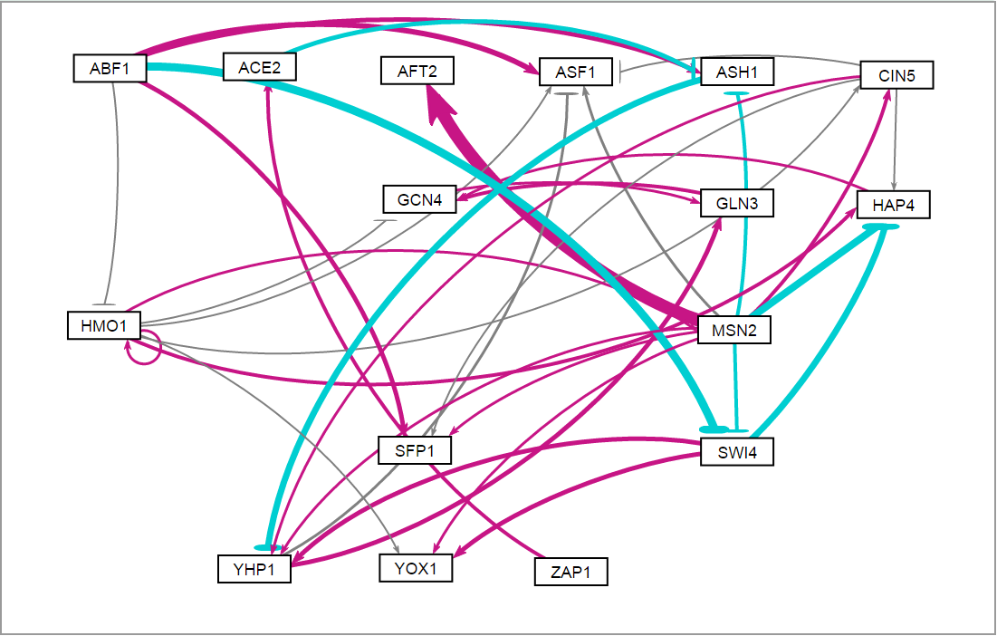
db1: Network Derived from wt Data
16 Genes, 26 Edges
Notes:
Source: https://github.com/kdahlquist/DahlquistLab/blob/master/documents/NEW_BK_GRNmap_Testing_network_presentation-all-strains_20161030.pptx

Slide 4
P-value Color Coding for Comparison.
db1: Network Derived from wt Data
16 Genes, 26 Edges
Notes:
Source: https://github.com/kdahlquist/DahlquistLab/blob/master/documents/NEW_BK_GRNmap_Testing_network_presentation-all-strains_20161030.pptx

Slide 5
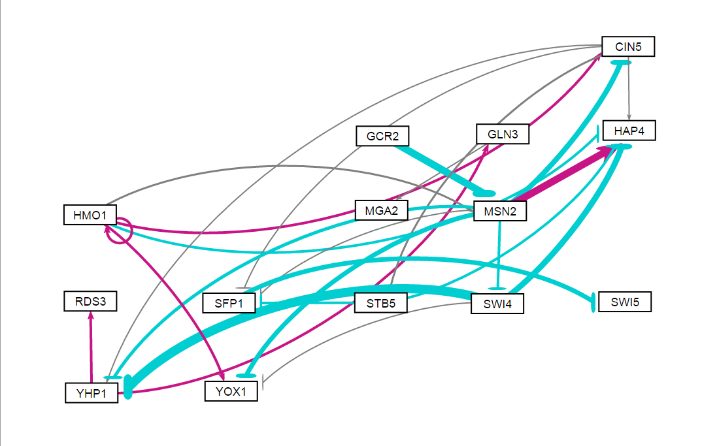
db2: Network Derived from ∆cin5 Data
14 Genes, 25 Edges
Notes:
Source: https://github.com/kdahlquist/DahlquistLab/blob/master/documents/NEW_BK_GRNmap_Testing_network_presentation-all-strains_20161030.pptx

Slide 6
P-value Color Coding for Comparison.
db2: Network Derived from ∆cin5 Data
14 Genes, 25 Edges
Notes:
Source: https://github.com/kdahlquist/DahlquistLab/blob/master/documents/NEW_BK_GRNmap_Testing_network_presentation-all-strains_20161030.pptx

Slide 7
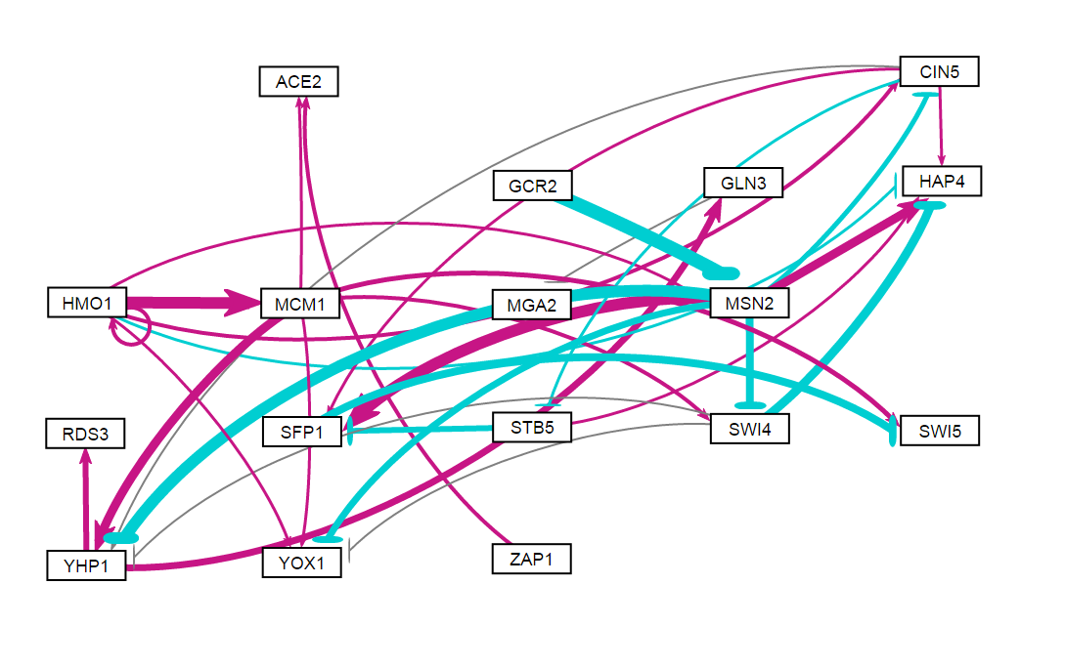
db3: Network Derived from ∆cin5 Data
17 Genes, 32 Edges
Notes:
Source: https://github.com/kdahlquist/DahlquistLab/blob/master/documents/NEW_BK_GRNmap_Testing_network_presentation-all-strains_20161030.pptx

Slide 8
P-value Color Coding for Comparison.
db3: Network Derived from ∆cin5 Data
17 Genes, 32 Edges
Notes:
Source: https://github.com/kdahlquist/DahlquistLab/blob/master/documents/NEW_BK_GRNmap_Testing_network_presentation-all-strains_20161030.pptx

Slide 9
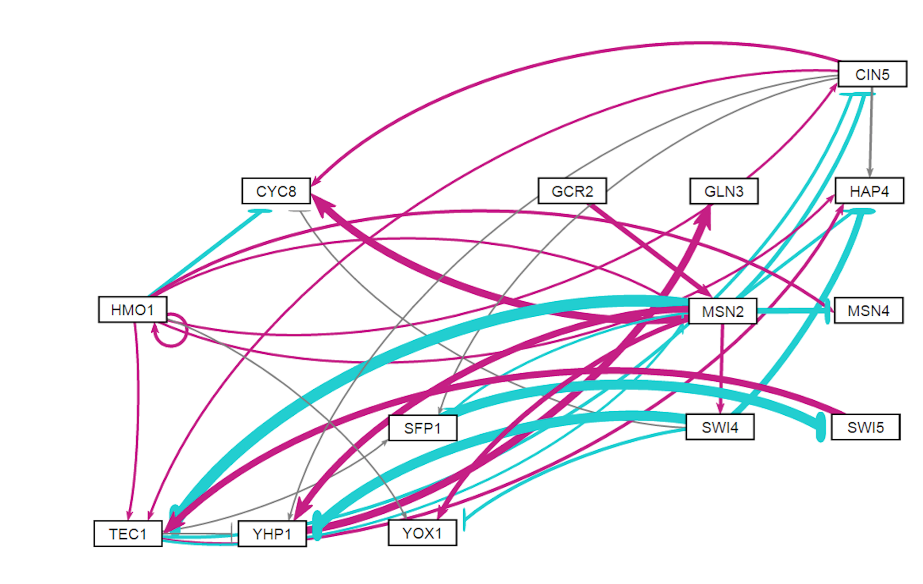
db4: Network Derived from ∆gln3 Data
14 Genes, 35 Edges
Notes:
Source: https://github.com/kdahlquist/DahlquistLab/blob/master/documents/NEW_BK_GRNmap_Testing_network_presentation-all-strains_20161030.pptx

Slide 10
P-value Color Coding for Comparison.
db4: Network Derived from ∆gln3 Data
14 Genes, 35 Edges
Notes:
Source: https://github.com/kdahlquist/DahlquistLab/blob/master/documents/NEW_BK_GRNmap_Testing_network_presentation-all-strains_20161030.pptx

Slide 11
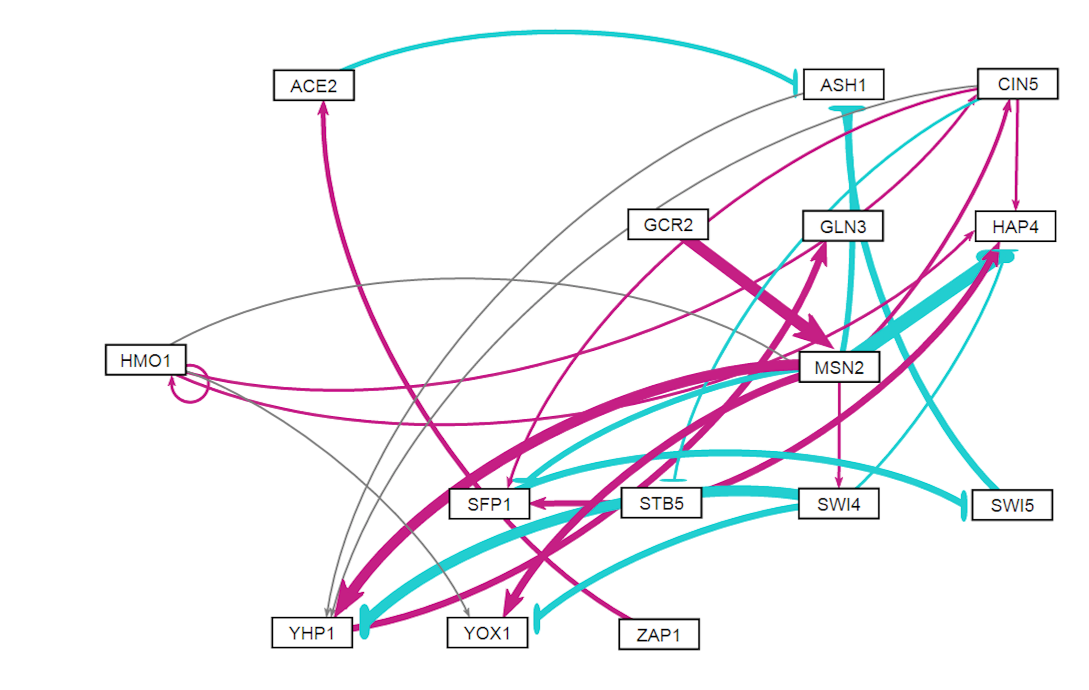
db5: Network Derived from ∆hap4 Data
15 Genes, 28 Edges
Notes:
Source: https://github.com/kdahlquist/DahlquistLab/blob/master/documents/NEW_BK_GRNmap_Testing_network_presentation-all-strains_20161030.pptx

Slide 12
P-value Color Coding for Comparison.
db5: Network Derived from ∆hap4 Data
15 Genes, 28 Edges
Notes:
Source: https://github.com/kdahlquist/DahlquistLab/blob/master/documents/NEW_BK_GRNmap_Testing_network_presentation-all-strains_20161030.pptx
*HMO1, CIN5, YHP1 involved in important regulatory relationships and significantly changing expression.
*It’s surprising that MSN2 only has 1 significant B&H p-value.
*STB5 consistently modeled with repression relationship… likely modeling noise.

Slide 13
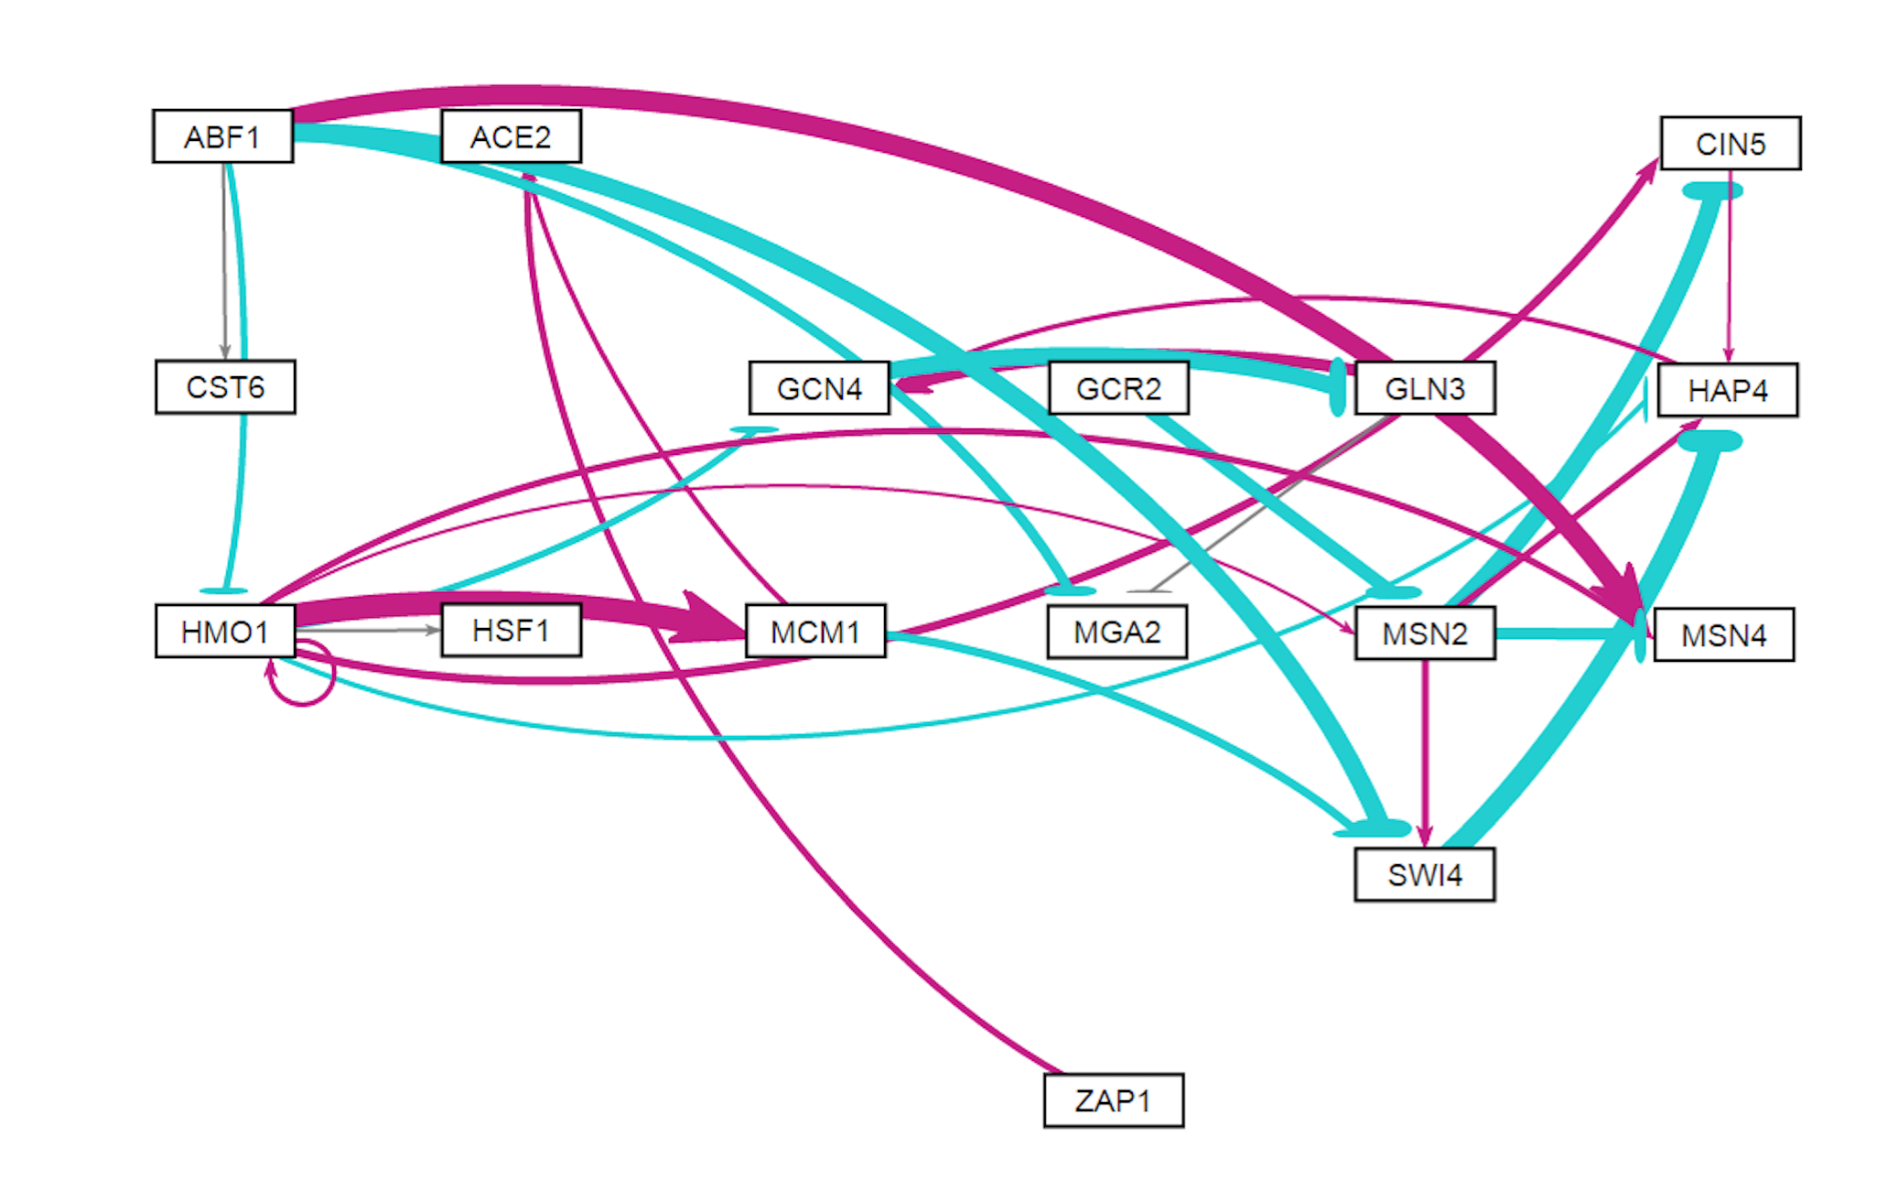
db6: Network Derived from ∆zap1 Data
16 Genes, 27 Edges
Notes:
Source: https://github.com/kdahlquist/DahlquistLab/blob/master/documents/NEW_BK_GRNmap_Testing_network_presentation-all-strains_20161030.pptx

Slide 14
P-value Color Coding for Comparison.
db6: Network Derived from ∆zap1 Data
16 Genes, 27 Edges
Notes:
Source: https://github.com/kdahlquist/DahlquistLab/blob/master/documents/NEW_BK_GRNmap_Testing_network_presentation-all-strains_20161030.pptx

